Slide 1
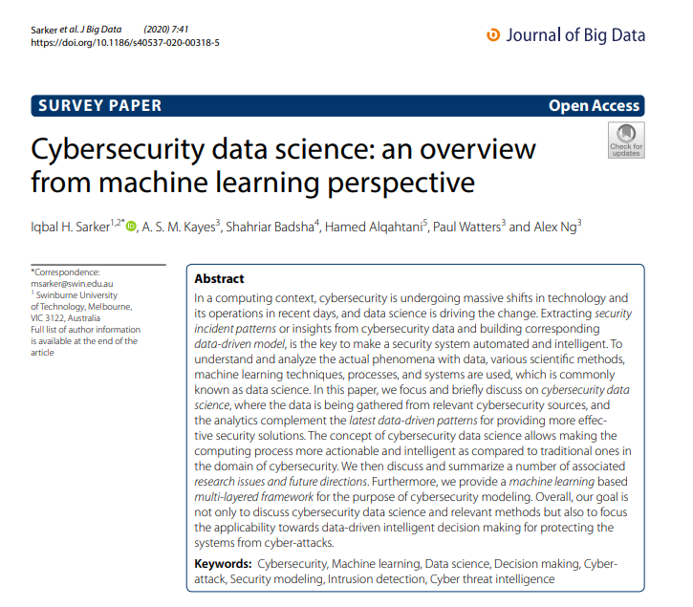

Slide 2
Affiliations
Swinburne University of Technology, Melbourne, VIC, 3122, Australia
Iqbal H. Sarker
Chittagong University of Engineering and Technology, Chittagong, 4349, Bangladesh
Iqbal H. Sarker
La Trobe University, Melbourne, VIC, 3086, Australia
A. S. M. Kayes, Paul Watters & Alex Ng
University of Nevada, Reno, USA
Shahriar Badsha
Macquarie University, Sydney, NSW, 2109, Australia
Hamed Alqahtani
Notes:
Dr. Iqbal H. Sarker (PhD, Australia)
Researcher and Faculty, Dept. of Computer Science & Engineering (CSE),

Slide 3


Realized by : Mr. Ayadi Mohamed Amine Proposed by : Dr . Chaker Katar & Dr. Neila Rjaibi
Cybersecurity data science
An overview from machine learning perspective
Academic year: 2021/2022

Slide 4

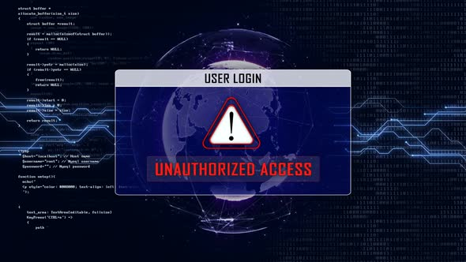




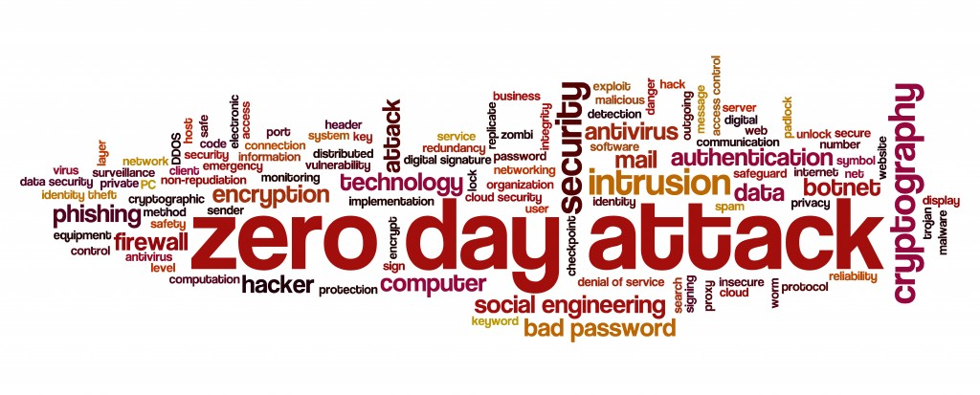
Introduction
Due to the increasing dependency on digitalization and Internet-of-Things (IoT) [1], various security incidents such as:
Notes:
Due to the increasing dependency on digitalization and Internet-of-Things (IoT) [1], various security incidents such as unauthorized access [2], malware attack [3], zero-day attack [4], data breach [5], denial of service (DoS) [2], social engineering or phishing [6] etc.

Slide 5


2010
2012
2019
50 million
100 million
900 million
Notes:
have grown at an exponential rate in recent years. For instance, in 2010, there were less than 50 million unique malware executables known to the security community.
By 2012, they were double around 100 million, and in 2019, there are more than 900 million malicious executables known to the security community, and this number is likely to grow, according to the statistics of AV-TEST institute in Germany [7].
AV-TEST is an independent organization which evaluates and rates antivirus and security suite software^{[1]} for Microsoft Windows and Android operating systems,^{[2]} according to a variety of criteria. The organisation is based in Magdeburg, Germany.^{[3]}

Slide 6
$ 8.19 million for the United States
3.9 million USD on average
Annual cost 400 billion USD
Cybercrime and attacks can lead to devastating financial losses and also affect organizations and individuals.
→ According to Juniper Research, the number of records broken each year will almost triple over the next 5 years.
→ Depending on a country's national security, depends on business, government and citizen access to highly secure applications and tools.
Therefore, effectively identifying various cyber incidents, whether observed or not, and intelligently protecting affected systems against such cyber attacks, is a key issue to be addressed urgently.
Notes:
It is estimated that a data breach costs US $ 8.19 million for the United States and US $ 3.9 million on average [8], and the annual cost of cybercrime to the global economy is US $ 400 billion [9 ].According to Juniper Research [10], the number of records broken each year will almost triple over the next 5 years. Thus, it is essential that organizations adopt and implement a robust cybersecurity approach to mitigate losses. According to [11], a country's national security depends on the access of businesses, government and citizens to highly secure applications and tools, as well as the ability to detect and eliminate these cyber threats in a timely manner. timely.Therefore, effectively identifying various cyber incidents, whether observed or not, and intelligently protecting affected systems against such cyber attacks, is a key issue to be addressed urgently.Juniper Research are providers of market data, forecasts and research for the global digital technology sector.

Slide 7
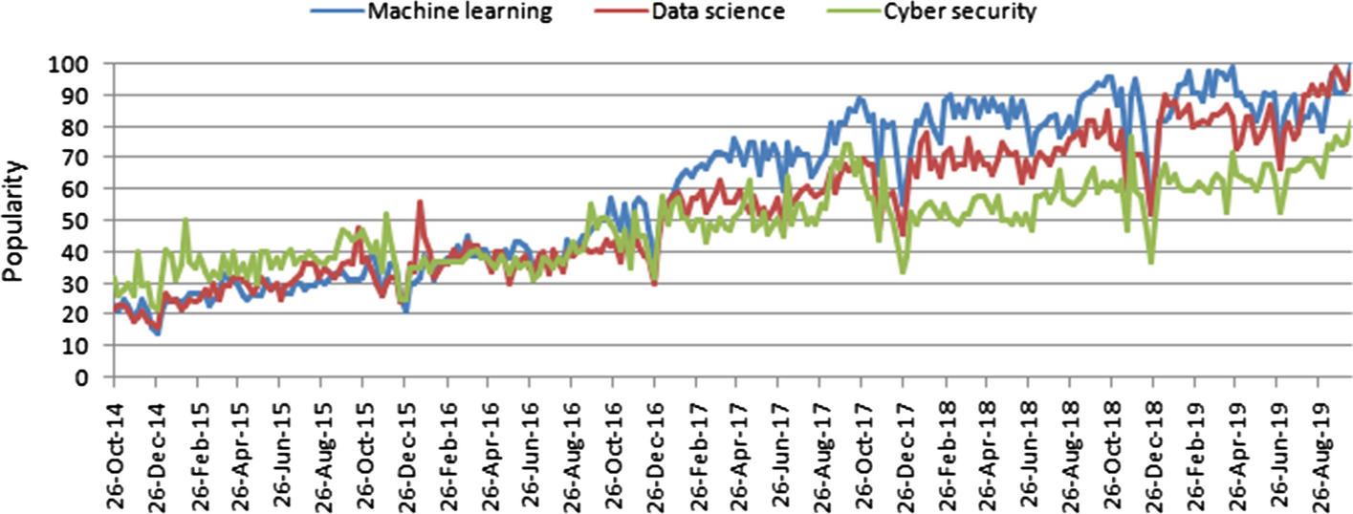
Google Trends
Data science, machine learning, and cybersecurity popularity trends over time, where the x-axis represents timestamp information and the y-axis represents corresponding popularity values
Notes:
Cyber security is a collection of technologies and processes designed to protect computers, networks, programs and data against attack, damage or unauthorized access [12].In recent days, cybersecurity is undergoing massive changes in technology and its operations in the context of computing, and data science (DS) is driving the change, where machine learning (ML) a central element Artificial intelligence (AI) can play a vital role in discovering information from data.

Slide 8

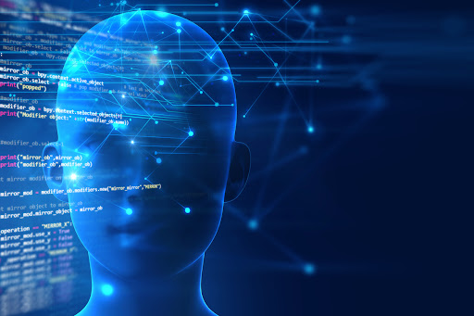
CDS is data-driven security, applies machine learning methods to quantify cyber risks, and ultimately seeks to optimize cybersecurity operations
→ Study and develop an intelligent data-driven cybersecurity model based on machine learning techniques.
Therefore, the emphasis is on a thorough description of the different types of machine learning methods.
CDS : Cybersecurity data science
Notes:
In this presentation, we focus on Cyber ​​Security Data Science (CDS), which is broadly related to these areas in terms of security data processing techniques and intelligent decision making in real world applications.
Overall, CDS is data-driven security, applies machine learning methods to quantify cyber risks, and ultimately seeks to optimize cybersecurity operations.
Therefore, the emphasis is on a thorough description of the different types of machine learning methods, as well as their relationships and use in the context of cybersecurity.
This presentation does not describe in detail all the different techniques used in cybersecurity; instead, it provides modeling insight into AI-powered cybersecurity data science, especially from a machine learning perspective.

Slide 9
The contributions of this paper are summarized as follows
We first make a brief discussion on the concept of cybersecurity data science and relevant methods to understand its applicability towards data-driven intelligent decision making in the domain of cybersecurity.
We then discuss and summarize a number of associated research issues and future directions in the area of cybersecurity data science,
Finally, we provide a generic multi-layered framework of the cybersecurity data science model based on machine learning techniques.
Notes:
1- For this purpose, we also make a review and brief discussion on different machine learning tasks in cybersecurity, and summarize various cybersecurity datasets highlighting their usage in different data-driven cyber applications.
2-That could help both the academia and industry people to further research and development in relevant application areas.
3- In this framework, we briefly discuss how the cybersecurity data science model can be used to discover useful insights from security data and making data-driven intelligent decisions to build smart cybersecurity systems.

Slide 10
PLAN
Background
Machine learning tasks in cybersecurity
A Multilayered Framework for Intelligent Cyber ​​Security Services
Conclusion
Cyber ​​Security Data Science
Notes:
Plan is organized as follows. he “Background” section provides an overview of technologies associated with cybersecurity data science.The "Cyber ​​Security Data Science" section defines cybersecurity data science, including various categories of cyber incident data. In the section "Machine learning tasks in cybersecurity", we discuss various categories of machine learning techniques, including their relationship to cybersecurity tasks and summarize a number of cybersecurity models based on machine learning on field.In the section “A Multilayered Framework for Intelligent Cyber ​​Security Services”, we suggest a machine learning-based framework to build a data science model of cybersecurity and discuss different layers with their roles.Finally, the “Conclusion” section concludes this presentation.

Slide 11
Background
Cybersecurity
Confidentiality Integrity The availability
Notes:
In this section, we provide an overview of technologies associated with cybersecurity data science, including various types of cybersecurity incidents and defense strategies.cybersecurity concerns the understanding of various cyber attacks and the design of corresponding defense strategies that preserve several properties defined below,Confidentiality is a property used to prevent access and disclosure of information to unauthorized people, entities or systems. Integrity is a property used to prevent unauthorized modification or destruction of information.Availability is a property used to ensure fast and reliable access of assets and information systems to an authorized entity.

Slide 12
Background
Cyber attacks and security risks
The threats Vulnerabilities The impacts
Notes:
The risks generally associated with any attack, which take into account three security factors, such as threats, i.e. who attacks, vulnerabilities, i.e. the weaknesses they attack, and impacts, ie what the attack does [9].

Slide 13
Background
Cyber security defense strategies
Data or information Information systems Networks against cyber attacks or intrusions
Notes:
Defense strategies are needed to protect data or information, information systems and networks against cyber attacks or intrusions.

Slide 14
Background
Data science
Advanced analytics and data science Intelligent data-driven decision-making
Notes:
We live in the age of data, advanced analytics and data science, that are linked to intelligent data-driven decision making.
Although the process of finding patterns or uncovering hidden and interesting knowledge from data is known as data mining [47],

Slide 15
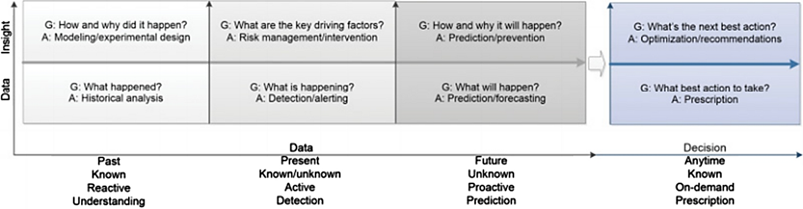
Steps from data analytics to understanding to decision making in data science
Notes:
The figure shows the typical transfer of data to preview to decision at different time periods and general analytical steps in data science, in terms of a variety of analytical goals (G) and approaches (A) to achieve data towards decision.

Slide 16

Cyber security data science
Understanding cybersecurity data
Data science is largely driven by the availability of data
Defining cybersecurity data science
Data science is transforming industries around the world. It is of crucial importance for the future of intelligent cybersecurity systems and services, because "security is first and foremost about data"
CDS
Machine learning tasks in CS
A Multilayered F, for Intelligent CS
Conclusion
Notes:
In this section we discuss the data science of cybersecurity, including various categories of cyber incident data with their use in different fields of application, as well as the key terms and areas related to our study

Slide 17
Machine learning tasks in cybersecurity
Machine learning (ML) is generally considered to be a branch of 'artificial intelligence', which is closely related to:
Computer statistics,
Data exploration and analysis,
Data science,
→ With a particular focus on how computers learn from data
Machine learning tasks in CS
CDS
A Multilayered F, for Intelligent CS
Conclusion
Notes:
Machine learning (ML) is generally considered a branch of "artificial intelligence", which is closely related to computer statistics, data mining and analysis, to data science, with a particular focus on how computers learn from data [82, 83].

Slide 18
Machine learning tasks in cybersecurity
Machine learning (ML) is generally considered to be a branch of 'artificial intelligence', which is closely related to:
Computer statistics,
Data exploration and analysis,
Data science,
→With a particular focus on how computers learn from data
Machine learning tasks in CS
CDS
A Multilayered F, for Intelligent CS
Conclusion
Notes:
Machine learning (ML) is generally considered a branch of "artificial intelligence", which is closely related to computer statistics, data mining and analysis, to data science, with a particular focus on how computers learn from data [82, 83].

Slide 19
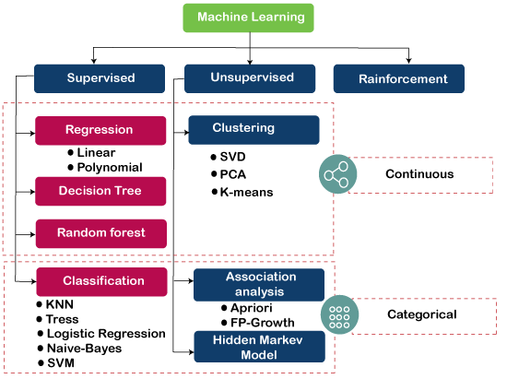
Machine learning tasks in CS
CDS
A Multilayered F, for Intelligent CS
Conclusion
Notes:
The different methods that can be used to solve machine learning tasks and how they relate to cybersecurity tasks.

Slide 20
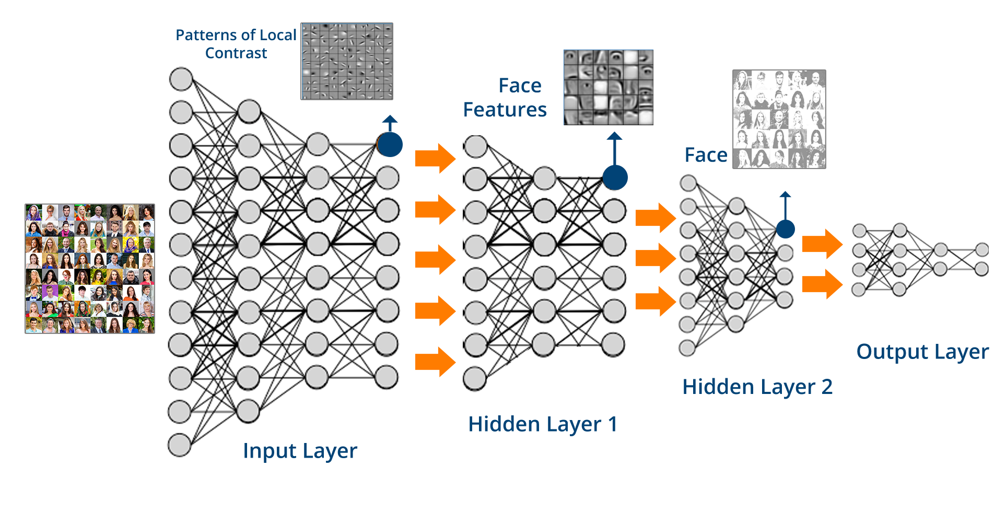
Machine learning tasks in CS
CDS
A Multilayered F, for Intelligent CS
Conclusion
Notes:
Deep learning is a part of machine learning in the area of artificial intelligence, which is a computational model that is inspired by the biological neural networks in the human brain [82].

Slide 21
A multi-layered framework for smart cybersecurity services
The science of cybersecurity data centers on:
Data,
Applies machine learning methods,
Attempts to quantify cyber risks,
Promotes inference techniques to analyze behavior patterns,
→For example, access control based on dynamic policy rules or an intrusion detection and prevention system.
A Multilayered F, for Intelligent CS
CDS
Machine learning tasks in CS
Conclusion
Notes:
As previously stated, cybersecurity data science is data-centric, applies machine learning methods, attempts to quantify cyber risks, promotes inference techniques to analyze patterns of behavior, focuses on generation security response alerts and ultimately seeks to optimize cybersecurity operations. Therefore, we briefly discuss a multiple data processing framework that can potentially be used to discover security information from raw data to create intelligent cybersecurity systems, for example, data-based access control. dynamic policy rules or an intrusion detection and prevention system.

Slide 22
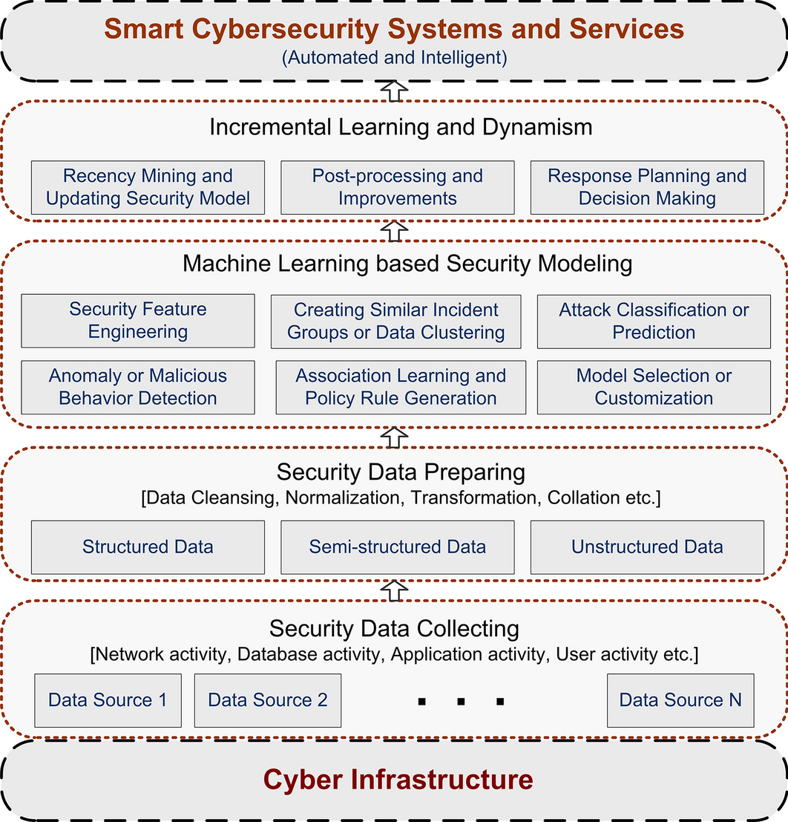
A generic multi-layered framework based on machine learning techniques for smart cybersecurity services
A Multilayered F, for Intelligent CS
CDS
Machine learning tasks in CS
Conclusion
Notes:
The figure shows an overview of the framework, involving multiple layers of processing, from raw data from security events to services.

Slide 23
The science of cybersecurity data and relevant methods,
The applicability to intelligent data-driven decision making in cybersecurity systems and services
Machine learning perspective.
Conclusion
CDS
Machine learning tasks in CS
A Multilayered F, for Intelligent CS
Notes:
The science of cybersecurity data and relevant methods,
but also to discuss the applicability of data-driven intelligent decision-making in cybersecurity systems and services from a machine learning perspective.
Our analysis and discussion may have several implications for both security researchers and practitioners.
For researchers, we have highlighted several issues and avenues for future research.

Slide 24
Abbreviations
DS: Data science
ML: Machine learning
AI: Artificial Intelligence
CDS: Cybersecurity data science
ICT: Information and communication technology
IoT: Internet of Things
DDoS: Distributed Denial of Service
IDS: Intrusion detection system
IPS: Intrusion prevention system
HIDS: Host-based intrusion detection systems
NIDS: Network Intrusion Detection Systems
SIDS: Signature-based intrusion detection system
AIDS: Anomaly-based intrusion detection system

Slide 25
References
Li S, Da Xu L, Zhao S. The internet of things: a survey. Inform Syst Front. 2015;17(2):243–59.
Sun N, Zhang J, Rimba P, Gao S, Zhang LY, Xiang Y. Data-driven cybersecurity incident prediction: a survey. IEEE Commun Surv Tutor. 2018;21(2):1744–72.
McIntosh T, Jang-Jaccard J, Watters P, Susnjak T. The inadequacy of entropy-based ransomware detection. In: International conference on neural information processing. New York: Springer; 2019. p. 181–189
Alazab M, Venkatraman S, Watters P, Alazab M, et al. Zero-day malware detection based on supervised learning algorithms of api call signatures (2010)
Shaw A. Data breach: from notifcation to prevention using pci dss. Colum Soc Probs. 2009;43:517.
Gupta BB, Tewari A, Jain AK, Agrawal DP. Fighting against phishing attacks: state of the art and future challenges.
Neural Comput Appl. 2017;28(12):3629–54.
Av-test institute, germany, https://www.av-test.org/en/statistics/malware/. Accessed 20 Oct 2019.
Ibm security report, https://www.ibm.com/security/data-breach. Accessed on 20 Oct 2019.
Fischer EA. Cybersecurity issues and challenges: In brief. Congressional Research Service (2014)
Juniper research. https://www.juniperresearch.com/. Accessed on 20 Oct 2019.
Papastergiou S, Mouratidis H, Kalogeraki E-M. Cyber security incident handling, warning and response system for the european critical information infrastructures (cybersane). In: International Conference on Engineering Applications of Neural Networks, p. 476–487 (2019). New York: Springer
etc,,,,,
Notes:
https://journalofbigdata.springeropen.com/articles/10.1186/s40537-020-00318-5#Sec10

